Slide 1
Analysis of Voice of Customer: Text Mining
© 2016 Megaputer Intelligence Inc.
Jonathan Frey, Ph.D.
Data Scientist with 30+ years at Taco Bell Corporation, Mars, Inc. and Kraft, Inc.
Sergei Ananyan, Ph.D.
CEO
Megaputer Intelligence, Inc.

Slide 2
Overview
Goals and techniques of text mining
Case study 1: Voice of Customer – restaurant example
Case study 2: Internal Service Desk example

Slide 3
Text Mining Goals and Techniques
Goals:
Understand customer responses
Transform the responses to actionable customer insights
Adapt the business actions to meet the customer need
Techniques:
Natural Language Processing (NLP)
Extracting features of interest from free text documents
Graphical representation of the findings
Summarization of results for the client

Slide 4
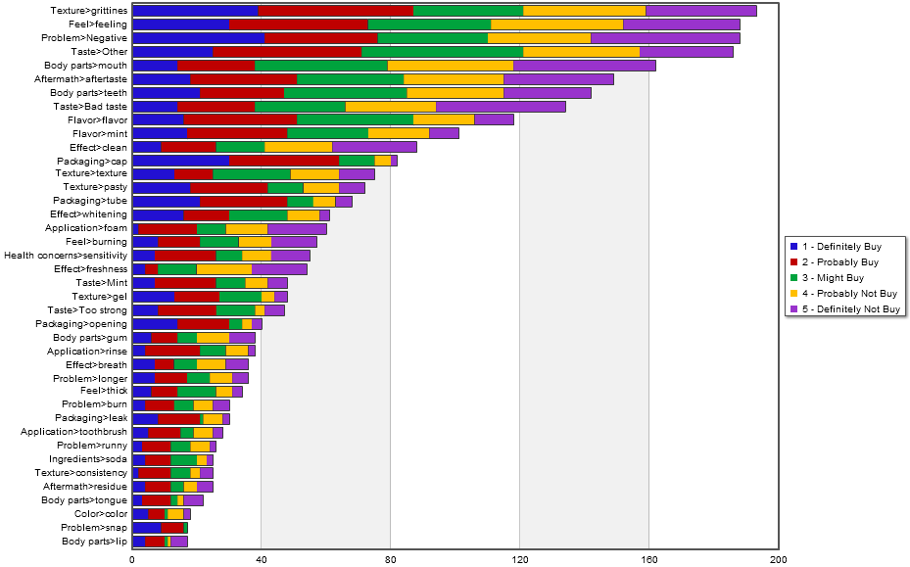
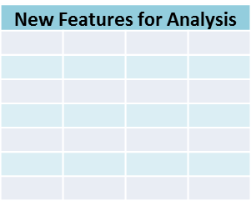
Text Mining Steps
Textual Data
Graphical Reports
1
Data Cleansing
2
Data-driven Analysis
3
Analyst-driven Analysis
4
Enriching Structured Data
OLAP cubes

Slide 5
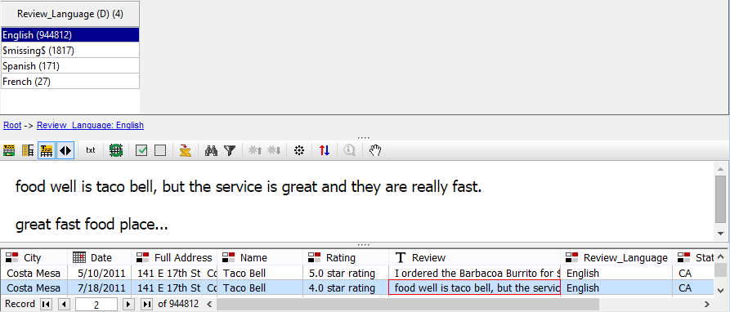
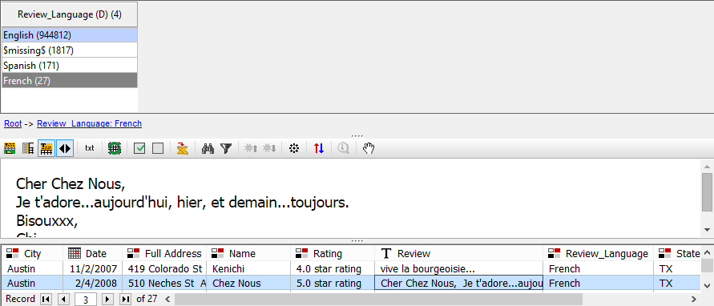
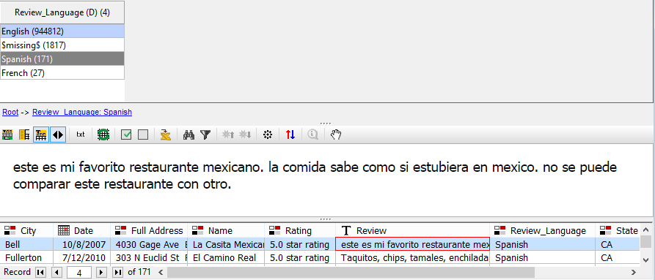
Language Detection
Automatically detect language of individual documents
English
French
Spanish

Slide 6
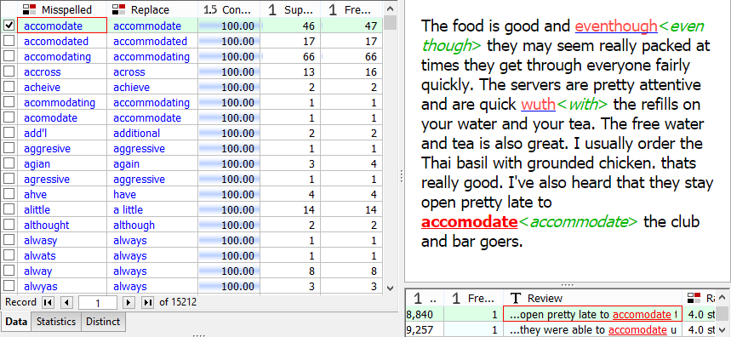
Spell Checker
Automatically detect & correct misspells

Slide 7
Science Behind the Analysis
Text Mining involves three types of analysis:
Linguistic
Phrase Analysis
Syntactic Analysis (Dependency Parsing)

Slide 8
Science Behind the Analysis
Text Mining involves three types of analysis:
Linguistic
Cable
Synonyms
Wire
Semantic
Hyponyms
Power Cable
Network Cable

Slide 9
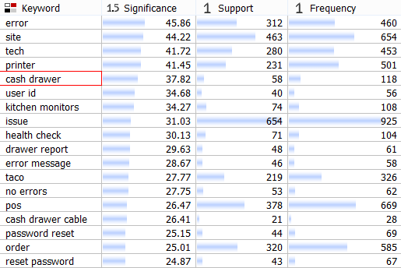
Science Behind the Analysis
Text Mining involves three types of analysis:
Linguistic
Statistical
Semantic

Slide 10
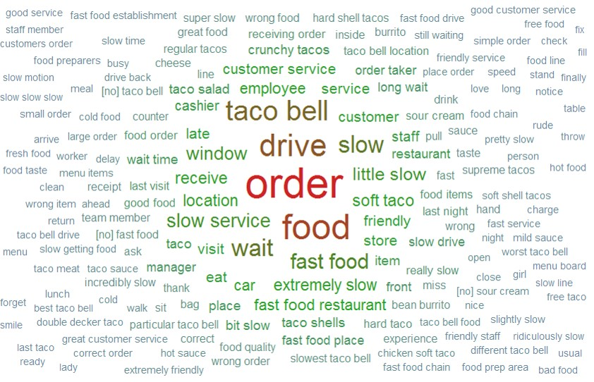
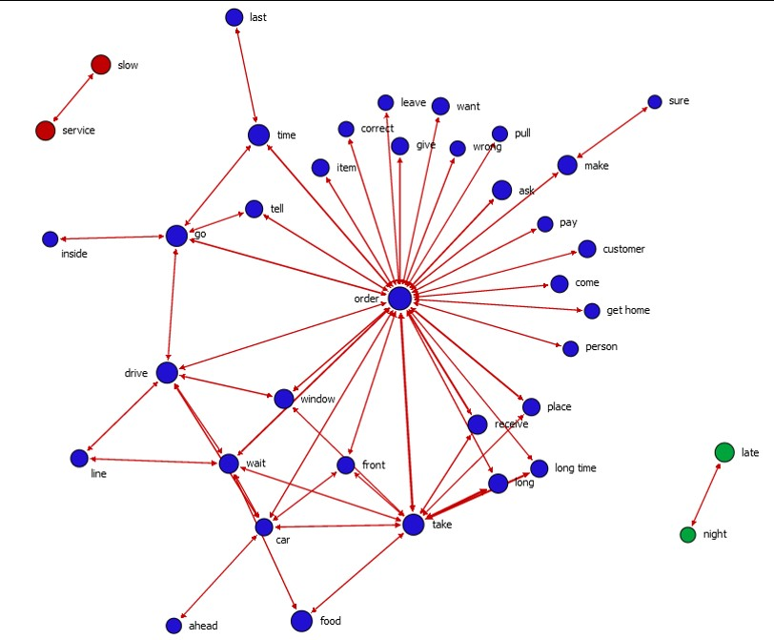
How Did We Do Text Mining?
Unsupervised analysis: let the data reveal its secrets
Detect most important words, phrases and relations between them
Elicit data-driven hierarchical structure for document classification

Slide 11
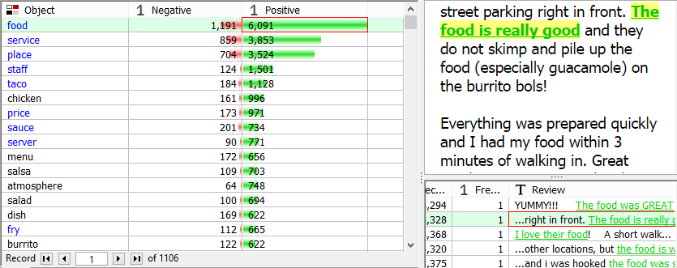
How Did We Do Text Mining?
Unsupervised analysis: let the data reveal its secrets
Detect most important words, phrases and relations between them
Elicit data-driven hierarchical structure for document classification

Slide 12
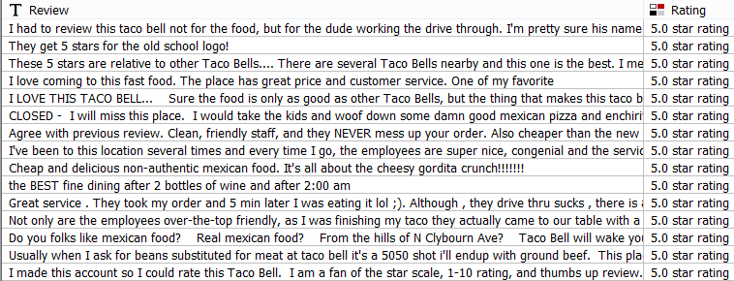
How Did We Do Text Mining?
Supervised analysis: build taxonomy queries for accurate classification of documents
Re-align results of unsupervised analysis to better reflect business objectives
Use linguistic, semantic and statistical information to create accurate queries

Slide 13
What Is a Taxonomy?
Taxonomy is a hierarchical collection of categories for document coding
Categories are defined by queries capturing features of interest in text
Scoring data against taxonomy accurately extracts structured information from unstructured text

Slide 14
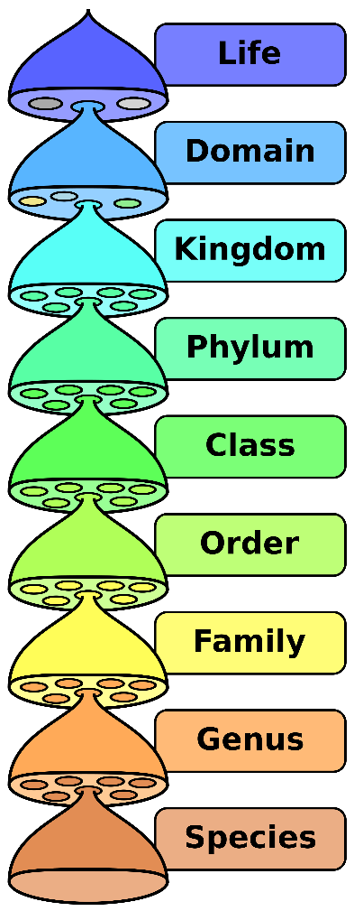
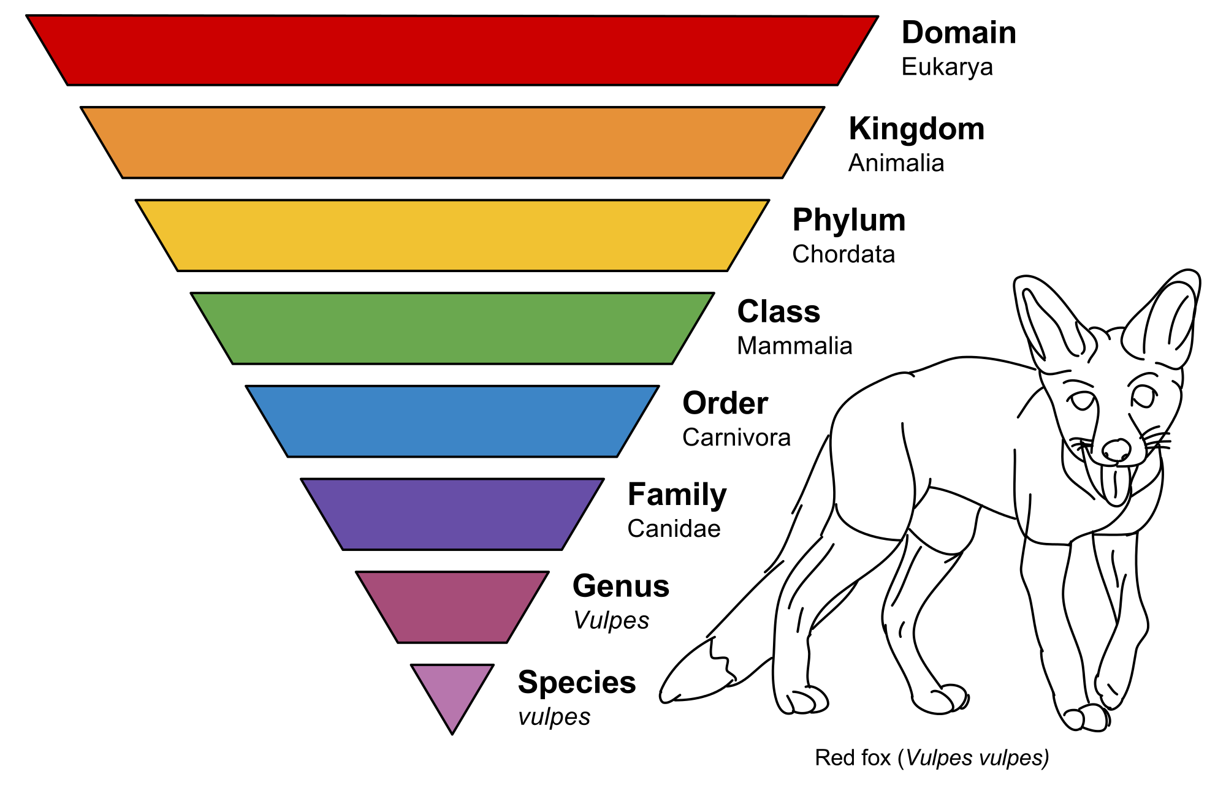
What Is a Taxonomy?
Likely 1st exposure to taxonomies

Slide 15
Taxonomy Definition
Categories
Queries

Slide 16
Taxonomy Definition
Categories
macro( snear, 7, negate( show or receive or display ), monitor or screen )
Queries

Slide 17
Taxonomy Results

Slide 18
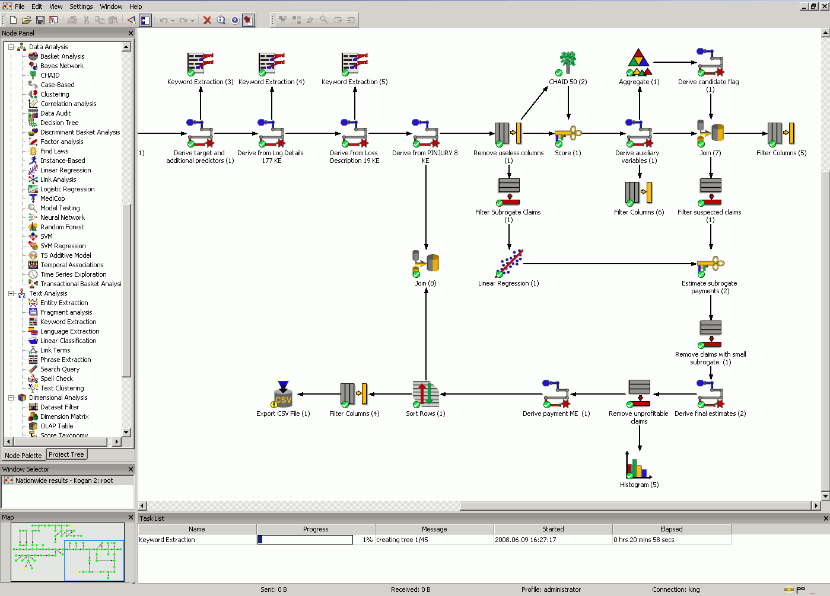
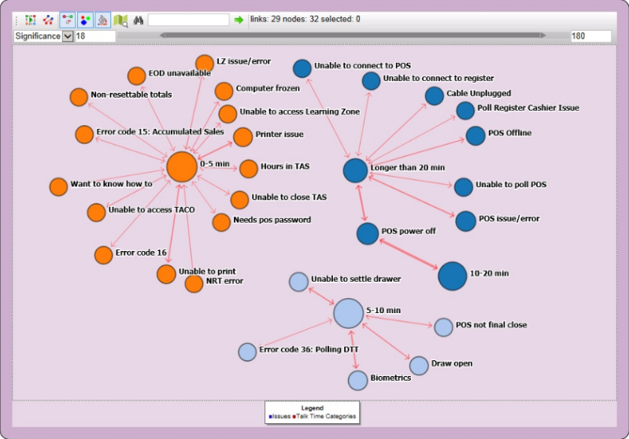
The Analytical Tool Used
PolyAnalyst™ offers:
Advanced text analysis capabilities
Integrated analysis of textual and structured data
Visual development of multi-step data analysis scenarios
Convenient visualization and interactivity capabilities
Simple generation of custom graphical reports

Slide 19
Case Study: Voice of Customer Data

Slide 20
Case Study – Voice of Customer Data
2,604,377 responses collected from a Voice of Customer website consisting of structured and unstructured data from December 2013 to June 2015
Structured data fields consist of
Overall Satisfaction
Recommend to a Friend
Service metrics associated with a quick service restaurant experience
Unstructured data consisted of responses from an open comment field
Website for responses was printed on the receipts with a chance to win a weekly drawing

Slide 21
Building the Taxonomy and Scoring for Sentiment
One year of historical data was used to build and train the algorithms for the taxonomy
Broad topic categories were constructed to align with KPI’s measured in the structured data
Taxonomy refined through inspection and SME input
Data set was scored with 2 additional new variables; broad category and specific issue/term
Due to the length of the comments many responses were assigned to multiple broad and specific issue categories
Data was also passed through a sentiment engine and scored as positive or negative
Additional variable created for sentiment rating

Slide 22
Broad Categories for Restaurant Taxonomy
Service
Staff
Product
Everything is fine
Other
Facilities
Suggestions
Pricing
Marketing
Sensitive Issues
Horrible Experience
Inquiry
Others

Slide 23
Overall Satisfaction Ratings for Service
1
2
3
4
5
Overall Satisfaction
Count
83% Satisfied

Slide 24
Sentiment Rating Distribution for Service
Positive
Sentiment: Service
Negative
88% Positive

Slide 25
Positive Sentiment: Specific Issues for Service
Friendly
Fast
Great Service
Correct Order
Service subcategories
Positive Sentiment
Polite
Welcoming
Good Attitude
Fast Delivery
Hold the Door

Slide 26
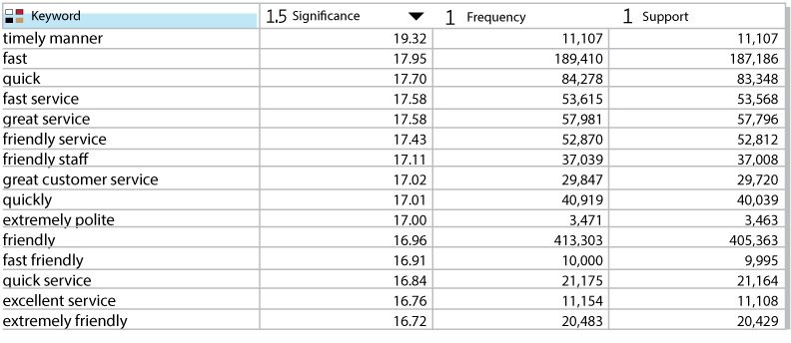
Positive Sentiment: Specific Keywords for Service

Slide 27
Overall Satisfaction Ratings: Positive Sentiment for Service
1
2
3
4
5
Overall Satisfaction
Positive Sentiment for Service
91% Satisfied

Slide 28
Negative Sentiment: Specific Issues for Service
Slow
Wrong Item
Poor Service
Not Friendly
Rude to Employee
No Utensils
Inattentive/Unhelpful
Did Not Wear Gloves
Service Subcategories
Negative Sentiment
Not Helpful
Incorrect Change
Incomplete Order
Ignored Guest
Refused Service
Rude to Guest
Partial Order Wrong
Partial Order Cold
Partial Order Missing
Unhappy Call Back

Slide 29
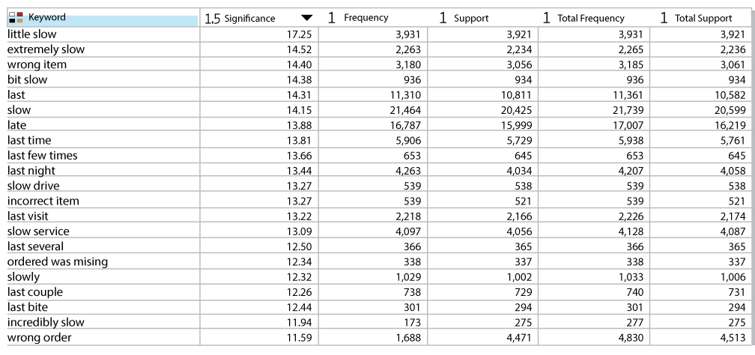
Negative Sentiment Service Specific Keywords

Slide 30
Overall Satisfaction Ratings: Negative Sentiment for Service
1
2
3
4
5
Overall Satisfaction
Negative Sentiment for Service
20% Satisfied

Slide 31
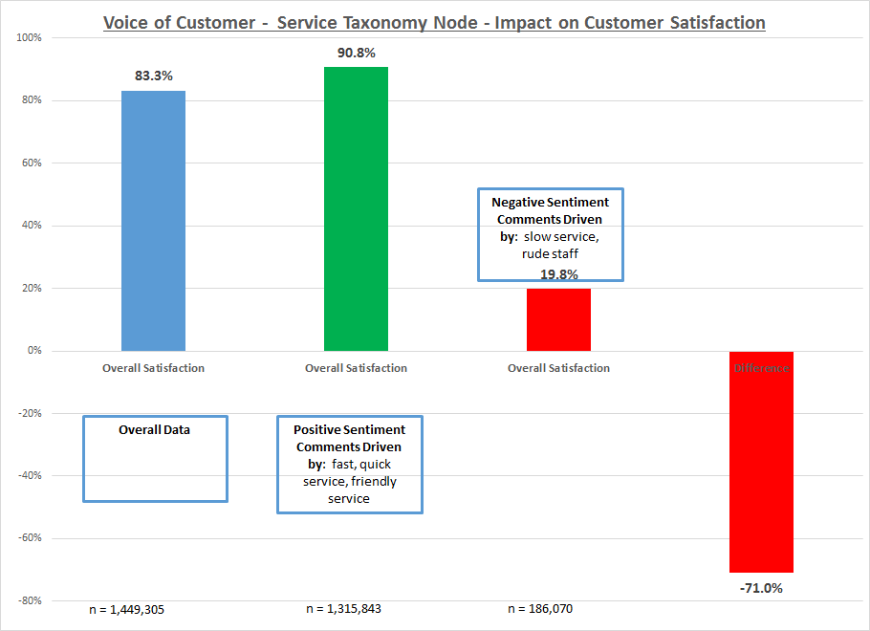
Most Important Factors To Focus On?
Example of
calculations
Notes:
How do we know what to focus on in this data? This graph shows the type of calculations that are conducted with each of the Positive and Negative Broad and Specific categories. In this example, Overall Satisfaction is impacted by 70% due to speed and friendliness issues

Slide 32
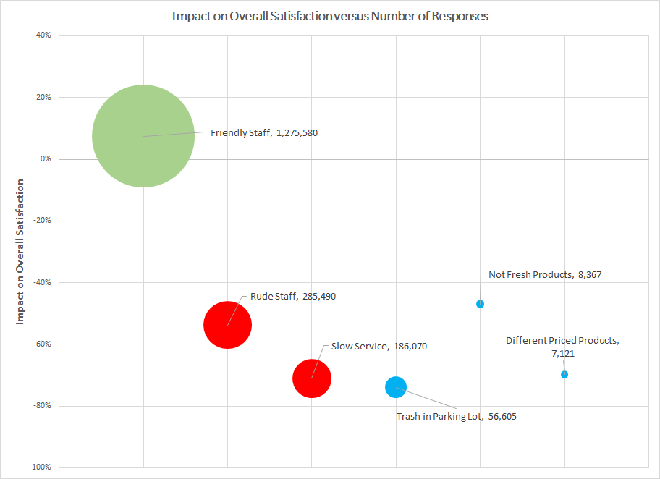
What Is the Most Important Factor to Focus On?
Friendly Staff, 1,275,580
Impact on Overall Satisfaction
Not Fresh Products, 8,367
Rude Staff, 285,490
Different Priced Products, 7,121
Slow Service, 186,070
Trash in Parking Lot, 56,605

Slide 33
Summary
Clear prioritization of what is important
Magnitude of issue impact on Customer Satisfaction
Provides clear insight and focus on what to work on

Slide 34
Text Mining Practices
Case Study: Internal Service Desk

Slide 35
Service Desk Overview
Supports 6,500 stores spanning hundreds of owner operators
Highly integrated technical architecture
Multiple Point of Sale hardware device types and software configurations
Critical integrations supporting sales and operations
Network connectivity challenges vary by geography
Evolving technologies demand rapid hardware and software deployment with minimal business disruptions. This requires a highly technical Service Desk positioned to deliver quality support.
Digital
Secure Payment
Customer Wifi
Social Media
Store team member engagement (eLearning, communication supporting tech savvy employees)
‘Insight to Action’ Store Reporting

Slide 36
Voice of Internal Customer
Internal service desk addresses computer hardware, software and connectivity issues
800 to 1,200 unique calls per day
Business critical issues addressed for the store, can restrict ability to conduct business processes including collecting revenue
Analyst choose call reasons from menu of issues on up to 5 levels of call classification – not clear differentiation of choices and mistakes are made
Open ended comments entered by analyst at multiple points of case – probably the most accurate information

Slide 37
An Urgent Business Need to be Addressed
Due to several software releases that conflicted with different hardware configurations, a spike in number of calls received at the service desk caused an increase in Average Speed of Answer of service calls
Volume and complexity of issues necessitated a change in diagnostic tools to rapidly get to root cause

Slide 38
Average Speed of Answer
The need for the project
was this graph – ASA increased
dramatically to unacceptable levels

Slide 39
Average Speed of Answer
The need for the project
was this graph – ASA increased
dramatically to unacceptable levels
Text Mining Solution
Implemented

Slide 40
Average Speed of Answer
The need for the project
was this graph – ASA increased
dramatically to unacceptable levels
Text Mining Solution
Implemented

Slide 41
Methodology
Previous analysis used sources of data independently:
Telephone system data (Cisco)
Call contact data (Remedy)
Now: import and join data from both sources twice daily over rolling 90 days timeframe
Calculate call center metrics from structured data and combine 3 open ended comment fields
Dictionary and taxonomy built from past year’s data
Data scored with taxonomy categories extracted from combined comment fields
Graphs and metrics based on taxonomy classification of text
Much more precise than call categories from 5 menu levels
Additional business metrics were easily linked to scored taxonomy for further rapid analysis

Slide 42
TreeMap Based on Taxonomy
Size of box represents the number of Issues
Green shows short call handle time.
Red shows longer call handle time.

Slide 43
Heat Map Based on Time of Day Analysis
Wednesday Tuesday
05:00
07:00
09:00
11:00
13:00
15:00
17:00
19:00
21:00
23:00
This Heat Map shows what day of the week and at what times major issues occur.

Slide 44
Issue Category Trends Based on Taxonomy
Issue Category
Call trend chart shows what are the major issues uncovered using the taxonomy and the call total handle time
DB
OCB
Home
Monetary
POS
TAS
Cannot Poll
Error Code
Menu
Phone
EOD
Loading Zone
Mobile Issues
Printer
Taco Issues
Cashier
Miscellaneous
Cable
Email
Password Reset
Bump
Screen or Monitor
eRestaurant Issues
No Network Access
Technical Problems

Slide 45
Link Analysis Based on Taxonomy
Link Analysis shows what are the major issues in blue.
Detailed issues are in red

Slide 46
Link Analysis Based on Taxonomy
Link Analysis shows what are the major issues in blue.
Detailed issues are in red

Slide 47
Day Trends Based on Taxonomy
Service Desk leaders can compare
issues reported on Weekdays
versus Weekends easily

Slide 48
Day Trends Based on Taxonomy
Service Desk leaders can compare
issues reported on Weekdays
versus Weekends easily
Red = Weekend
Blue = Weekday

Slide 49
Day Trends Based on Taxonomy
Issues: DB not in sync
Service Desk leaders can compare
issues reported on Weekdays
versus Weekends easily
Issues: DB User ID error
Issues: DB User ID already being used
Red = Weekend
Blue = Weekday

Slide 50
Analyst Performance
Service Desk leaders can compare
analyst metrics at a glance

Slide 51
Result – As Call Volume Increased, ASA decreased!
Average Speed of Answer
Call Volume
Text Mining Solution
Implemented

Slide 52
A New Way of Working
New Metric Reports became part of Service Desk standard operating procedures
Emerging issues are now identified and addressed swiftly
Executive leadership visibility to store issues and service levels
Renewed confidence in the Service Desk

Slide 53
Text Mining Practices
Questions?
Jonathan Frey
jonathan_frey@icloud.com
Sergei Ananyan
sananyan@megaputer.com

